Slide 1

TCP/IP Basics
Chapter 6

Slide 2
Objectives
Describe how the TCP/IP protocol suite works
Explain CIDR and subnetting
Describe the functions of static and dynamic IP addresses

Slide 3
Historical/Conceptual
Standardizing Networking Technology

Slide 4
Early Days of Networking Software (1 of 2)
Several competing standards
Protocols: individual rules used by software
Protocol suites: many protocols lumped together
Novell Netware: IPX/SPX
Microsoft: NetBIOS/NetBEUI
Apple: AppleTalk
UNIX: TCP/IP

Slide 5
Early Days of Networking Software (2 of 2)
TCP/IP won out as the protocol of choice
Only protocol on the CompTIA Network+ exam

Slide 6
Test Specific
The TCP/IP Protocol Suite

Slide 7
The TCP/IP Model (1 of 3)
Introduced in Chapter 1
Top three layers
Internet, Transport, and Application

Slide 8
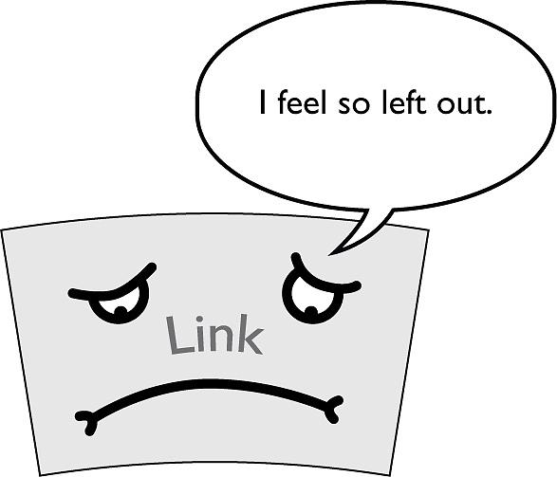
The TCP/IP Model (2 of 3)
Figure 6.1 The Link layer is important, but it’s not part of the TCP/IP protocol suite

Slide 9
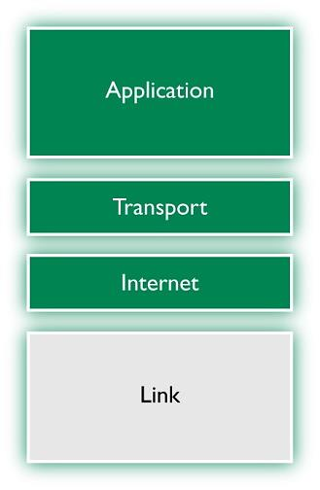
The TCP/IP Model (3 of 3)
Figure 6.2 The TCP/IP protocol suite redux
Notes:
Note (p. 132): The TCP/IP protocol suite consists of thousands of different protocols doing thousands of different things. For the most part, the rest of this book discusses TCP/IP protocols. Right now, my goal is to give you an idea of which protocols go where in the TCP/IP protocol suite.

Slide 10
The IP Packet (1 of 2)
Parts of an IP packet fit perfectly into layers of the TCP/IP model
Header for a higher layer is part of the data for a lower layer
Example: a packet’s payload can be a TCP segment that consists of data from the layers above and a sequence number

Slide 11
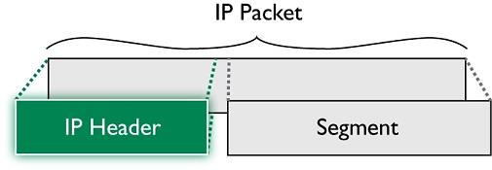
The IP Packet (2 of 2)
Figure 6.3 IP packet showing headers

Slide 12
Internet Layer Protocols
Concerned with addressing
Example IP address: 192.168.1.115
Internet Protocol version four (IPv4)
Older type of addresses
IPv6 is a longer type of address
Example: 2001:0:4137:9376:43e:2599:3f57:fe9a

Slide 13
Other Internet Layer Protocols (1 of 2)
Internet Control Message Protocol (ICMP)
Features called automatically by applications
Example: ping used to query whether a host is reachable
Notes:
Note (p. 133): The TCP/IP model’s Internet layer corresponds roughly to the OSI model’s Network layer.

Slide 14
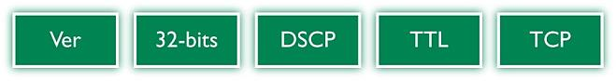
Other Internet Layer Protocols (2 of 2)
Figure 6.4 Simplified IP header

Slide 15
Fields in a Full IP Packet Header
Version
Header length
Differentiated services code point (DSCP)
Time to live (TTL)
Protocol

Slide 16
Transport Layer Protocols
Determines if the data is:
Connection-oriented ► Transmission Control Protocol (TCP) or
Connectionless ► User Datagram Protocol (UDP)
Application-layer protocols determine which protocol is used - TCP or UDP

Slide 17
TCP (1 of 2)
Used by most TCP/IP applications
Communication rules require sending and receiving machines to acknowledge the other’s presence and readiness
Chops up data into segments
Each segment has a sequence number
Each application is assigned a specific port number on which to listen/send

Slide 18
TCP (2 of 2)
Figure 6.5 TCP three-way handshake in action

Slide 19
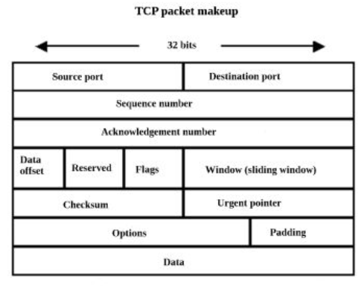
Fields in the TCP Header (1 of 2)
Source port and destination port
Sequence and ACK numbers
Flags
Checksum

Slide 20
Fields in the TCP Header (2 of 2)
Figure 6.6 TCP header

Slide 21
UDP (1 of 2)
“Fire-and-forget” protocol
Used when data must simply be sent without worrying about a few dropped pieces here and there
Very fast protocol
Examples: VoIP, DHCP, and DNS
Used by Domain Name System (DNS) and Dynamic Host Configuration Protocol (DHCP)

Slide 22

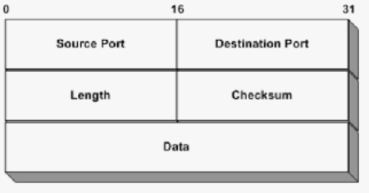
UDP (2 of 2)
Figure 6.7 UDP header
Notes:
Note (p. 135): You saw this back in Chapter 1, but I’ll mention it again here. Data gets chopped up into chunks at the Transport layer when using TCP. The chunks are called segments with TCP. UDP datagrams don’t get chopped up at the Transport layer; they just get a header.

Slide 23
Application Layer Protocols (1 of 2)
TCP/IP protocols used to move data back and forth
Application headers differ between applications
Sample header from HTTP shown in Figure 6.8
Notes:
Note (p. 135): I’m simplifying the call and response interaction between a Web server and a Web client. The explanation here is only the first part of the process in accessing a Web page.

Slide 24
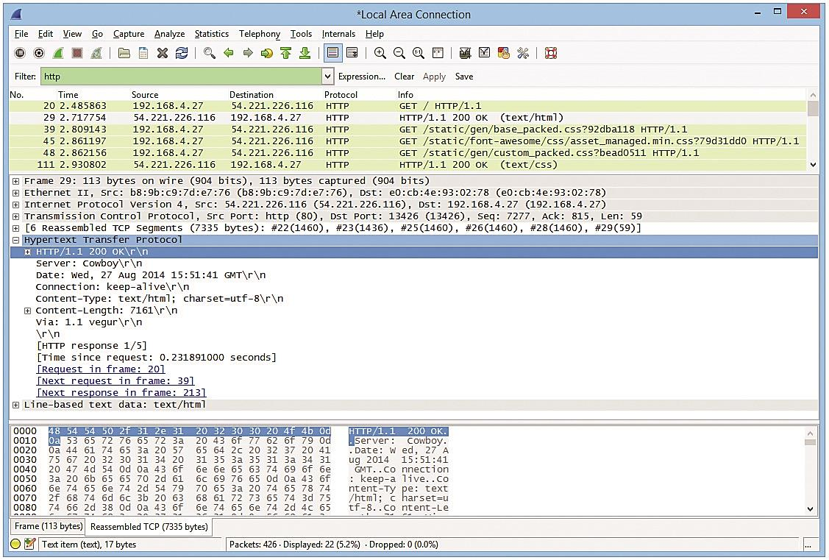
Application Layer Protocols (2 of 2)
Figure 6.8 HTTP header

Slide 25
IP and Ethernet

Slide 26
TCP: LANs and WANs
TCP/IP suite supports simple and complex networks
Small LAN
Multiple LANs connected to form a WAN

Slide 27
TCP/IP on LAN over Ethernet (1 of 6)
On small network, sending computer broadcasts using MAC address FF-FF-FF-FF-FF-FF to obtain recipient’s MAC address
Broadcasting is disastrous to a large network

Slide 28
TCP/IP on LAN over Ethernet (2 of 6)
Figure 6.9 Two addresses

Slide 29
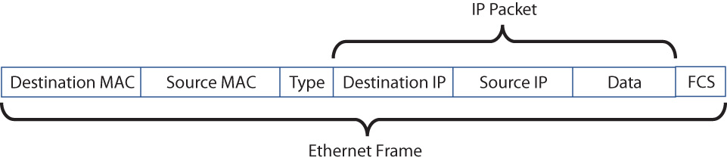
TCP/IP on LAN over Ethernet (3 of 6)
Figure 6.10 Encapsulation

Slide 30
TCP/IP on LAN over Ethernet (4 of 6)
Figure 6.11 What is this MAC address?

Slide 31
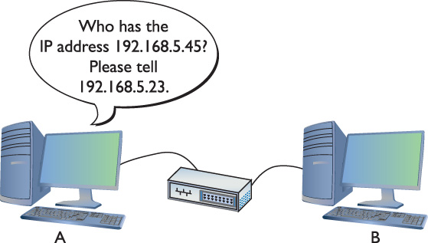
TCP/IP on LAN over Ethernet (5 of 6)
Figure 6.12 Sending an ARP request

Slide 32
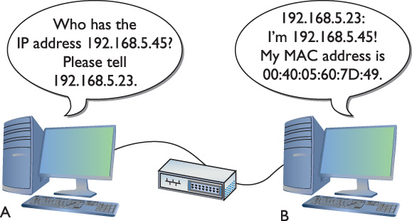
TCP/IP on LAN over Ethernet (6 of 6)
Figure 6.13 Computer B responds
Notes:
Try This! (p. 137): ARP in Windows
To show Windows’ current ARP cache, open a command line and type
arp –a
You should see results like this:
Interface: 192.168.4.71 --- 0x4
Internet Address Physical Address Type
192.168.4.76 00-1d-e0-78-9c-d5 dynamic
192.168.4.81 00-1b-77-3f-85-b4 dynamic
Now delete one of the entries in the ARP table with this command:
arp –d [ip address from the previous results]
Run the arp –a command again. The line for the address you specified should be gone. Now ping the address you deleted and check the ARP table again. Did the deleted address return?

Slide 33
IP Addressing
Overcomes limitations of Ethernet networks
Unique IP address per host
Unique address per logical network
Communicate between LANs without constant broadcasts
Notes:
Cross Check (P. 138): The OSI Seven-Layer Model
This chapter uses the TCP/IP model to describe the interactions among the various components and protocols involved in a TCP/IP network. But the OSI model is exceptionally important in modern networking, and you should recognize how parts fit into it as well. You learned about this in Chapter 1, so refer back and cross check your knowledge. What layer (number and name) handles the interaction with Ethernet hardware? What about MAC addressing versus IP addressing? Which layers deal with naming?

Slide 34
IP Addresses (IPv4)
32-bit value
Example: 11000000101010000000010000000010
Broken into four groups of eight 11000000.10101000.00000100.00000010
Each 8-bit value is converted into a decimal number between 0 and 255
Notes:
This entire chapter focuses on IPv4

Slide 35
Binary to Decimal Conversion
Binary | Decimal
00000000 | 0
00000001 | 1
00000010 | 2
00000011 | 3
00000100 | 4
00000101 | 5
00000110 | 6
00000111 | 7
00001000 | 8
(skip a bunch) | (skip a bunch)
Binary | Decimal
11111000 | 248
11111001 | 249
11111010 | 250
11111011 | 251
11111100 | 252
11111101 | 253
11111110 | 254
11111111 | 255

Slide 36
Binary, Decimal, and Octal Numbering (1 of 2)
Converted address in dotted decimal notation
11000000101010000000010000000010 is displayed as 192.168.4.2
Know how to convert dotted decimal to binary and back
Every OS has a calculator
Notes:
Check out the two excellent Chapter 6 “Binary Calculator” sims over at http://totalsem.com/007. View the Show!, then practice on the Click!

Slide 37
Binary, Decimal, and Octal Numbering (2 of 2)
Figure 6.14 Windows (left) and macOS (right) Calculators in Programmer mode
Notes:
Note (p. 139): Using a calculator utility to convert to and from binary/ decimal is a critical skill for a network tech. Later on you’ll do this again, but by hand!

Slide 38
Using a Calculator for Conversions (1 of 2)
Decimal to binary conversion
Enter a value in decimal view
Switch to binary view to convert the value
Leading zeroes do not display in the calculator
Leading zeroes are important when working with IP addresses

Slide 39
Using a Calculator for Conversions (2 of 2)
Figure 6.15 Converting decimal to binary with Windows 10 Calculator

Slide 40
MAC and IP Addressing (1 of 5)
Every MAC address must be unique on a network
Every IP address must be unique
Every computer on a small TCP/IP network has both an IP address and a MAC address
An operating system utility displays addresses
A command-line utility is also available

Slide 41
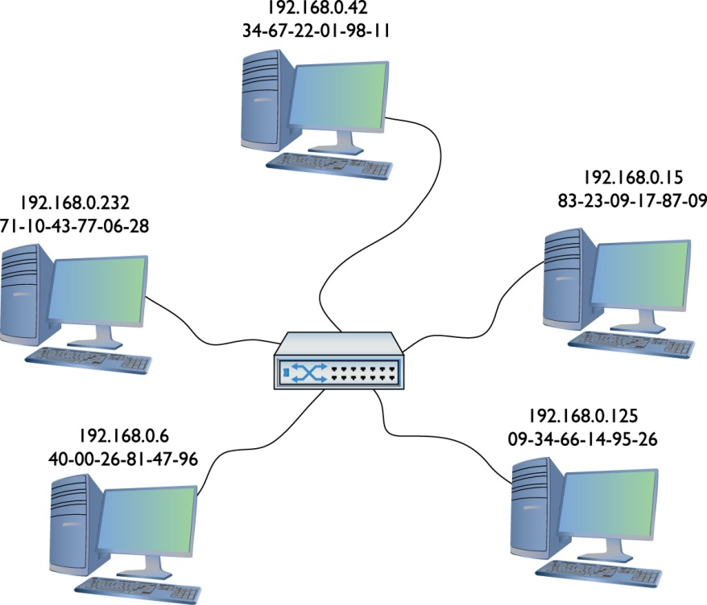
MAC and IP Addressing (2 of 5)
Figure 6.16 A small network with both IP and MAC addresses

Slide 42
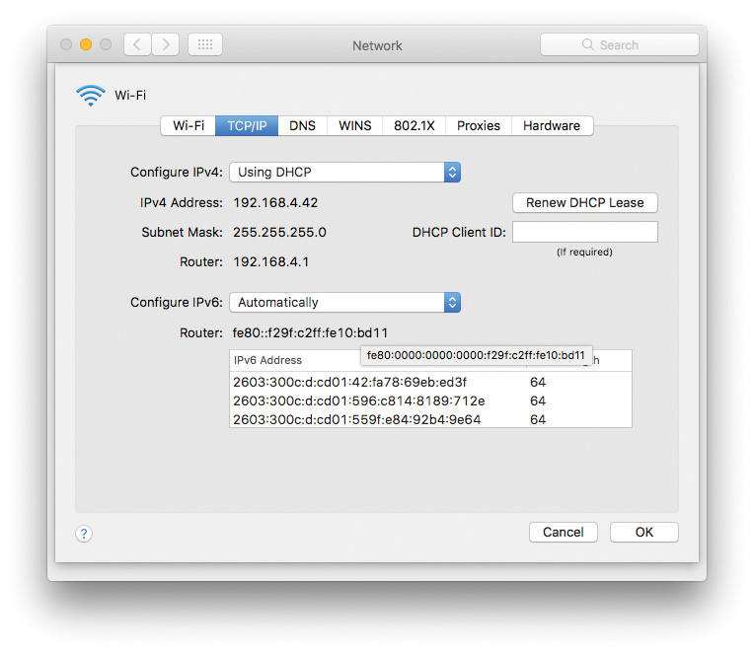
MAC and IP Addressing (3 of 5)
Figure 6.17 macOS Network utility

Slide 43
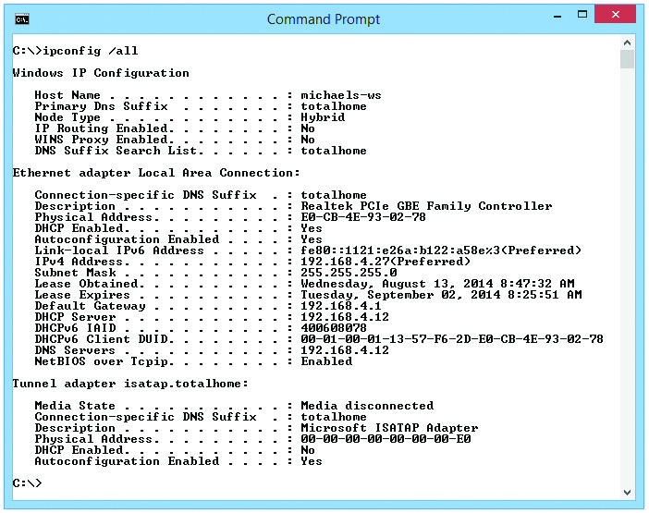
MAC and IP Addressing (4 of 5)
Figure 6.19 ipconfig /all results

Slide 44
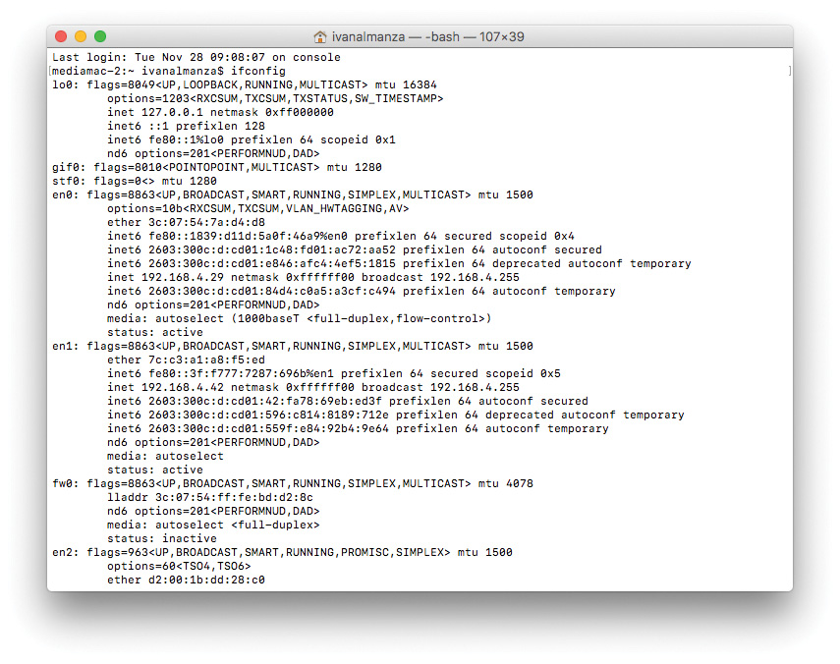
MAC and IP Addressing (5 of 5)
Figure 6.20 Results from running ifconfig in macOS
Notes:
Exam Tip (p. 143): Make sure you know that ipconfig and ifconfig provide a tremendous amount of information regarding a system’s TCP/IP settings.

Slide 45
IP Addresses in Action
IP addresses support LANs and WANs
Functions of IP
Creates a way to use IP addresses so each LAN has its own identification
Interconnects all LANs using routers
Gives each computer a way to recognize whether a packet is for the LAN or the WAN

Slide 46
Network IDs (1 of 2)
All computers on same LAN must share a similar IP address
First group of numbers will be the same
Last group of numbers will be unique

Slide 47
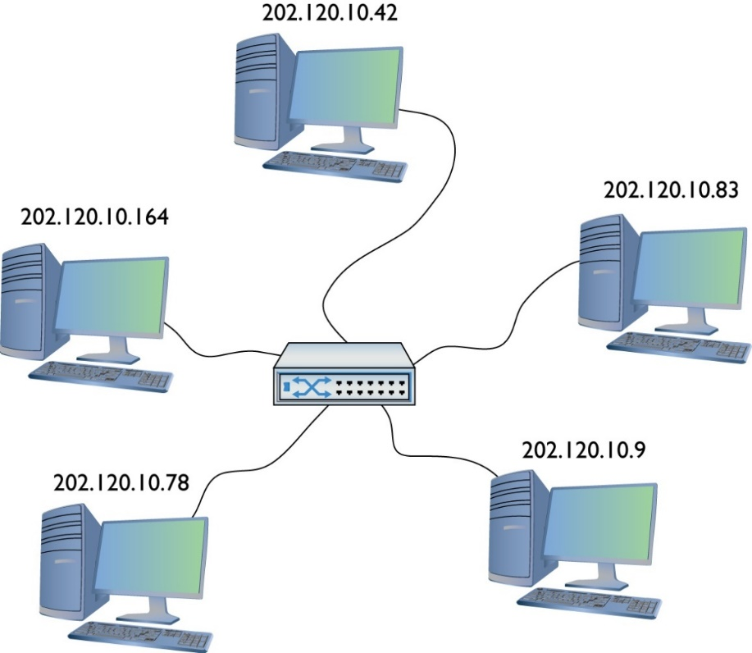
Network IDs (2 of 2)
Figure 6.22 IP addresses for a LAN
Notes:
Note (p. 144): Two things to note here. First, the network ID and the host ID are combined to make a system’s IP address. Second, a host ID can end in 0—although this is uncommon—but we have to discuss subnetting before any of this will make sense. Read on!

Slide 48
Interconnecting LANs (1 of 5)
Requires a router connection
Router requires an IP address on each LAN
Default gateway
Router interface
Network administrators often give lowest host address in the network to the router

Slide 49
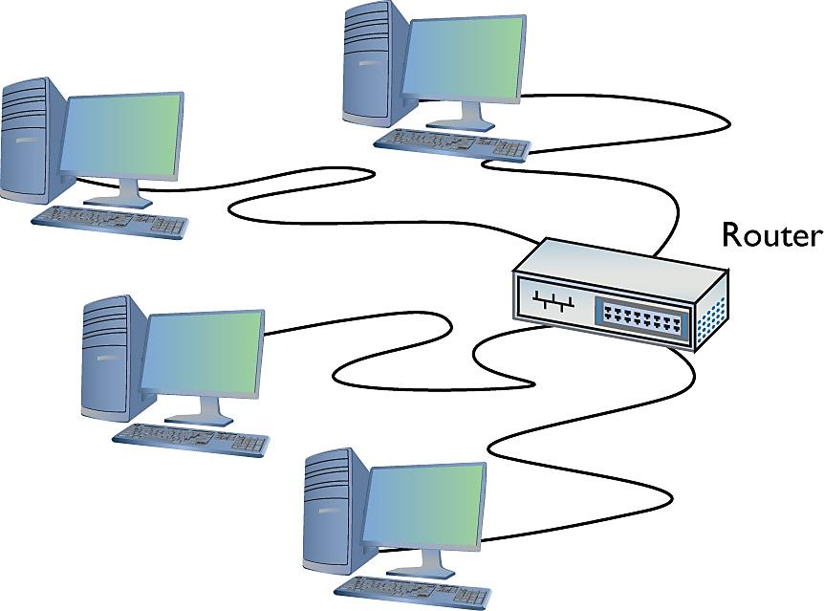
Interconnecting (2 of 5)
Figure 6.23 LAN with router

Slide 50
Interconnecting (3 of 5)
Routers use network IDs to determine network traffic
Routing table
Instructions that tell the router what to do with incoming packets and where to send them

Slide 51
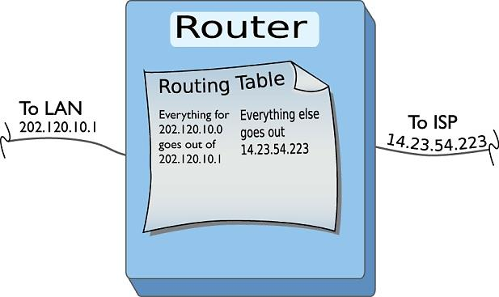
Interconnecting (4 of 5)
Figure 6.24 Router diagram
Notes:
Note (p. 145): Routing tables are covered in more detail in Chapter 7.

Slide 52
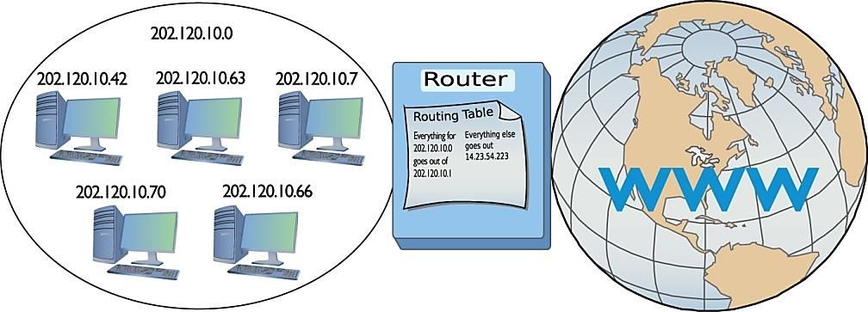
Interconnecting (5 of 5)
Figure 6.25 LAN, router, and the Internet

Slide 53
Limitations of Network ID Formats
Number of zero values at the end determines maximum number of hosts
Examples:
202.120.10.0 limited to 254 addresses
170.45.0.0 has a total of 65,534 hosts
12.0.0.0 has a total of 16.7 million hosts
Network IDs allow make it possible to connect multiple LANs into a WAN

Slide 54
Subnet Mask (1 of 3)
Different processes used to send a packet to local and remote computers
Local computer: send a broadcast
Remote computer: send packet to the default gateway
Processes are illustrated in Figures 6.26 and 6.27
Subnet mask
String of ones followed by some number of zeros
Notes:
Exam Tip (P. 146):
At this point, you should memorize that 0 = 00000000 and 255 = 11111111. You’ll find knowing this very helpful throughout the rest of the book.

Slide 55
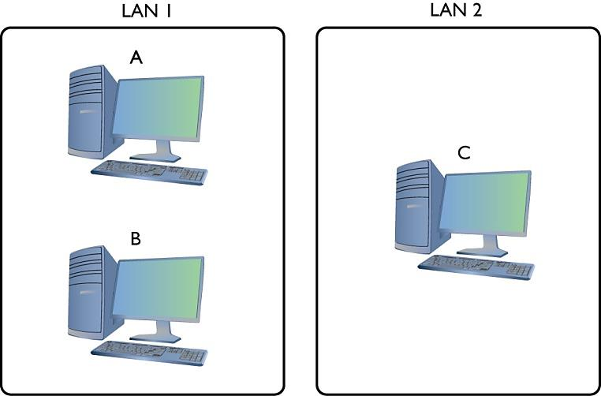
Subnet Mask (2 of 3)
Figure 6.26 The three amigos, separated by walls or miles

Slide 56
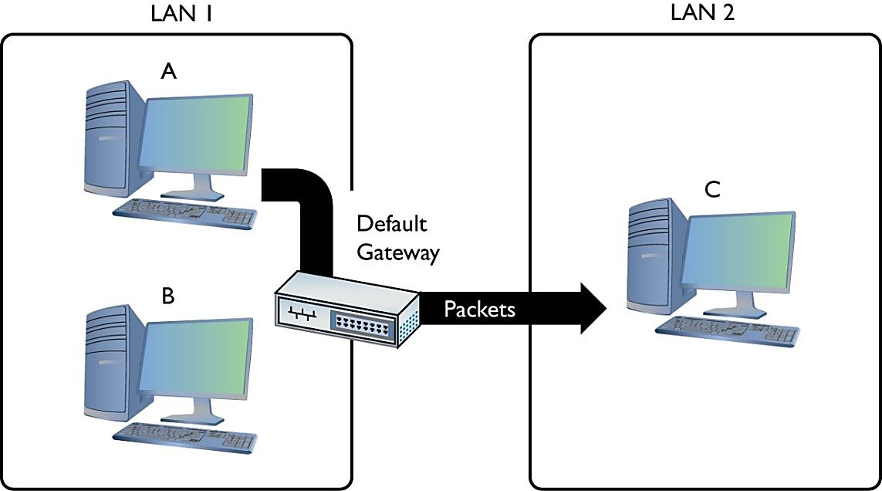
Subnet Mask (3 of 3)
Figure 6.27 Sending a packet remotely

Slide 57
Using the Subnet Mask (1 of 2)
Line up an IP address with a corresponding subnet mask in binary
The portion of the IP address that aligns with the ones of the subnet mask is the network ID of the IP address
The portion of the IP address that aligns with the zeroes is the host ID

Slide 58
Using the Subnet Mask (2 of 2)
 | Dotted Decimal | Binary
IP address | 192.168.5.23 | 11000000.10101000.00000101.00010111
Subnet mask | 255.255.255.0 | 11111111.11111111.11111111.00000000
Network ID | 192.168.5.0 | 11000000.10101000.00000101.x
Host ID | x.x.x.23 | x.x.x.00010111

Slide 59
Comparing Addresses (1 of 2)
Steps
The sending computer compares the destination IP address to its own IP address using the subnet mask
If the destination IP address matches the computer IP wherever there’s a 1 in the subnet mask, the destination is local
If not, the address is remote
Notes:
Note (p. 147): The explanation about comparing an IP address to a subnet mask simplifies the process, leaving out how the computer uses its routing table to accomplish the goal. We’ll get to routing and routing tables in Chapter 7. For now, stick with the concept of the node using the subnet mask to determine the network ID.

Slide 60
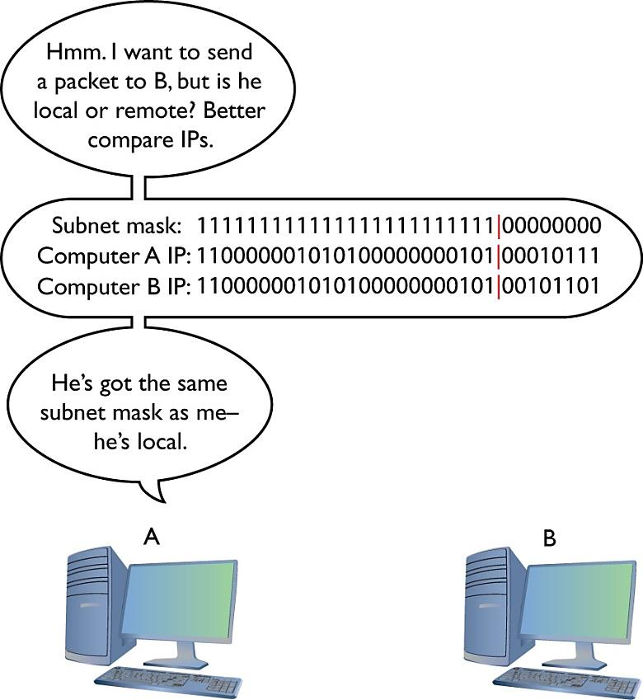
Comparing Addresses (2 of 2)
Figure 6.28 Comparing addresses

Slide 61
ARP and the OSI Model (1 of 6)
For a local destination address, sending computer sends out an Address Resolution Protocol (ARP) broadcast to determine the destination computer’s MAC address
An ARP packet contains the sending computer’s IP address and the destination address

Slide 62
ARP and the OSI Model (2 of 6)
The destination computer responds by sending an ARP response containing its MAC address
The sending computer can now send data packets to the destination

Slide 63
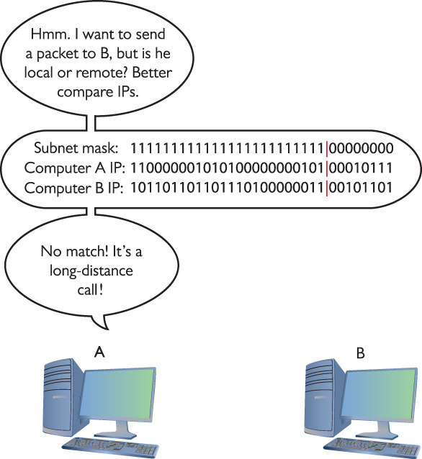
ARP and the OSI Model (3 of 6)
Figure 6.29 Comparing addresses again

Slide 64

ARP and the OSI Model (4 of 6)
Figure 6.30 Sending an ARP request to the gateway

Slide 65
An Example of a Valid Subnet Mask
11111111111111111111111100000000 = 255.255.255.0
11111111111111110000000000000000 = 255.255.0.0
11111111000000000000000000000000 = 255.0.0.0
11111111111111111111111100000000 = /24 (24 ones)
11111111111111110000000000000000 = /16 (16 ones)
11111111000000000000000000000000 = /8 (8 ones)
Notes:
Note (p. 149): By definition, all computers on the same network have the same subnet mask and network ID.

Slide 66
Tips for Setting Up Subnet Masks
Network administrators must enter the correct IP address and subnet mask when setting up a system
The networking software does the rest
If you want a computer to work in a routed network, you must configure the computer correctly with an IP address, a subnet mask, and a default gateway

Slide 67
Class IDs (1 of 2)
No two devices on the Internet can share the same IP address
Internet Assigned Number Authority (IANA) tracks/disperses IP addresses in network blocks
IANA oversees several Regional Internet Registries (RIRs)
RIRs in turn pass out IP addresses to large ISPs
ISPs pass out IP addresses to most end users
Notes:
Note (p. 149): The Internet Corporation for Assigned Names and Numbers (ICANN) manages IANA.

Slide 68
Class IDs (2 of 2)
 | First Decimal Value | Addresses | Hosts per Network ID
Class A | 1–126 | 1.0.0.0–126.255.255.255 | 16,277,214
Class B | 128–191 | 128.0.0.0–191.255.255.255 | 65,534
Class C | 192–223 | 192.0.0.0–223.255.255.255 | 254
Class D | 224–239 | 224.0.0.0–239.255.255.255 | Multicast
Class E | 240–254 | 240.0.0.0–254.255.255.255 | Experimental
Notes:
Exam Tip (p. 149): CompTIA and many techs use the term classful to describe the traditional class blocks. Thus you’ll see classful A, B, C, and D addressing on the exam. Keep reading and this will make sense.

Slide 69
Ways to Send a Packet
Three ways
Broadcast to every computer on the LAN
Unicast from one computer to another computer
Multicast from one computer to a group
Often used by routers
Multicast class blocks are often used for one-to-many communication
Example: streaming video conferencing
Notes:
Exam Tip (p. 150): Make sure you memorize the IP class blocks! You should be able to look at any IP address and know its class block. Here’s a trick to help: The first binary octet of a Class A address always begins with a 0 (0xxxxxxx); for Class B, it begins with a 10 (10xxxxxx); for Class C, with 110 (110xxxxx); for Class D, with 1110 (1110xxxx); and for Class E, it begins with 1111 (1111xxxx).

Slide 70
Class Blocks
IP class blocks were allocated generously at first
Unallocated IP addresses became scarce
IP class blocks concept did not scale well
If you needed 2000 IP addresses, you had to take a single Class B or eight Class C blocks
Solution
Classless Inter-Domain Routing (CIDR)

Slide 71
CIDR and Subnetting

Slide 72
CIDR and Subnetting
Subnetting chops up a single class of IP addresses into multiple smaller groups
CIDR and subnetting are virtually the same thing
Subnetting is done by an organization on a block of addresses to create multiple subnetworks
CIDR is done by an ISP on a block of addresses to create multiple subnets to pass out to customers
Notes:
Exam Tip (p. 150): Expect a question on the exam that compares the loopback and reserved addresses. Loopback are the 129.x.x.x addresses; Reserved are the Experimental addresses.

Slide 73
Subnetting
Advantages of subnetting
Allows more efficient use of IP addresses than class blocks
Enables separation of networks for security
Ensures bandwidth control
Subnet mask is cornerstone of subnetting
Extend subnet masks of /8, /16, or /24 subnet by adding more ones (removing equal number of zeroes)
Notes:
Exam Tip (p. 150): You need to know how to subnet to pass the CompTIA Network+ exam.

Slide 74
An Example of Subnetting (1 of 4)
Subnetting an Internet café
50 computers
40 public computers
10 back office computers
10 wireless clients (maximum)
Network ID 192.168.4/24
Must prevent people using the public system from accessing the private machines

Slide 75
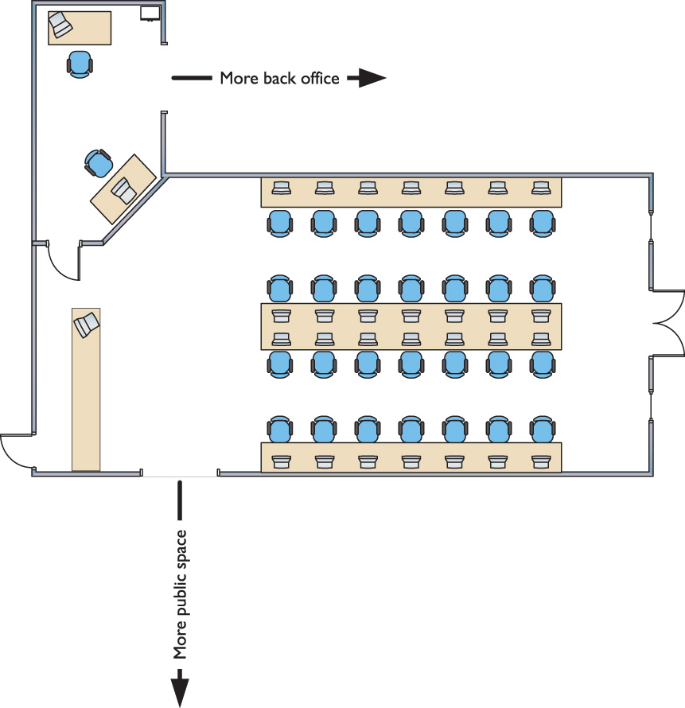
An Example of Subnetting (2 of 4)
Figure 6.31 Layout of the network

Slide 76
An Example of Subnetting (3 of 4)
Begin with the given subnet mask and move it to the right until you have the number of subnets you need
Forget the dots
Don’t be limited to /8, /16, /24 networks
Network IDs do not need to end on the dots
Create subnets of /26, /27, /22, and so on

Slide 77
An Example of Subnetting (4 of 4)
192.168.4.0/24
Change a zero to a one in the subnet mask
/24 becomes a /25 subnet
11111111111111111111111110000000

Slide 78
Calculating the Maximum Number of Hosts (1 of 2)
Example: hosts on a /24 network
192.168.4.1 to 192.168.4.254 = 254 hosts
Calculate in binary
In a /24 network, eight binary digits are used for the host ID
00000001 to 11111110 = 254 hosts
2⁸ – 2 = 254 total hosts
Memorize the formula for the number of hosts
2^{x} – 2 (x = the number of zeroes in the subnet mask)
Notes:
Note (p. 151): Classful subnets are always /8, /16, or /24. When we stop using that convention and start using classless subnet masks, we are using a custom subnet mask.

Slide 79
Calculating the Maximum Number of Hosts (2 of 2)
Maximum number of hosts on a /16 network
In a /16 network, 16 zeroes are part of the host ID
2¹⁶ – 2 = 65,534 total hosts
Maximum number of hosts on a /26 network
In a /26 network, 6 zeroes are part of the host ID
2⁶ – 2 = 62 total hosts

Slide 80
Your First Subnet (1 of 3)
Convert the 192.168.4.0/24 network ID into three network IDs
Write out the subnet mask in binary
Place a line at the end of the ones
See Figure 6.32
Draw a second line one digit to the right
See Figure 6.33
Notes:
Note (p. 152): You cannot subnet without using binary!

Slide 81
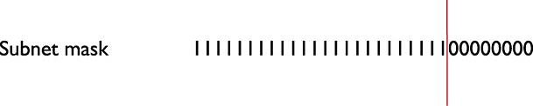
Your First Subnet (2 of 3)
Figure 6.32 Step 1 in subnetting

Slide 82
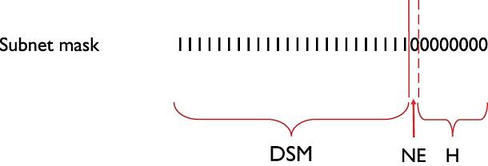
Your First Subnet (3 of 3)
Figure 6.33 Organizing the subnet mask

Slide 83
The Format of a Subnet Mask (1 of 2)
The subnet mask is now separated into three areas (these are not in official terms)
Default Subnet mask (DSM)
Network ID extension (NE)
Hosts (H)
This is now a /25 subnet mask

Slide 84
The Format of a Subnet Mask (2 of 2)
A subnet mask is always 32 binary digits long
A string of ones followed by a string of zeroes
11111111111111111111111110000000
Put periods between every eight digits
11111111.11111111.11111111.10000000
Then convert to dotted decimal
The resulting subnet mask: 255.255.255.128

Slide 85
Other Types of Subnet Masks
Subnet masks can and do use more than 255s and 0s (in dotted decimal form)
Examples of legitimate subnet masks
255.255.255.224
255.255.128.0
255.248.0.0

Slide 86
Calculating Subnets (1 of 2)
Start with a beginning subnet mask
Extend the subnet extension until you have the number of subnets you need
Formula is 2^{y}, where y is number of bits added to the subnet mask

Slide 87
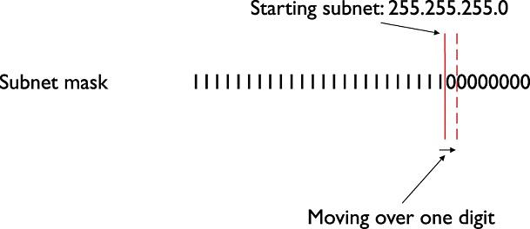
Calculating Subnets (2 of 2)
Figure 6.34 Initial subnetting

Slide 88
Subnet /24 to /26 (1 of 3)
Adds two digits, creating four new network IDs
Convert the original network ID to binary and add the four different network ID extensions to the end

Slide 89
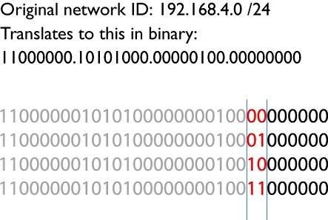
Subnet /24 to /26 (2 of 3)
Figure 6.35 Creating the new network IDs

Slide 90
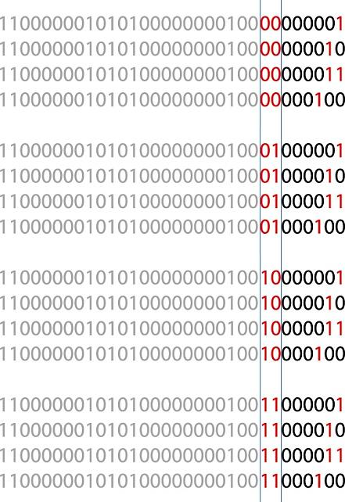
Subnet /24 to /26 (3 of 3)
Figure 6.36 New network ID address ranges

Slide 91
The New Network IDs in Decimal (1 of 2)
Network ID | Host Range | Broadcast Address
192.168.4.0/26 | (192.168.4.1–192.168.4.62) | 192.168.4.63
192.168.4.64/26 | (192.168.4.65–192.168.4.126) | 192.168.4.127
192.168.4.128/26 | (192.168.4.129–192.168.4.190) | 192.168.4.191
192.168.4.192/26 | (192.168.4.193–192.168.4.254) | 192.168.4.255
Notes:
Note (p. 154): If wasting subnets seems contrary to the goal of efficient use, keep in mind that subnetting has two goals: efficiency and making multiple network IDs from a single network ID. This example is geared more toward the latter goal.

Slide 92
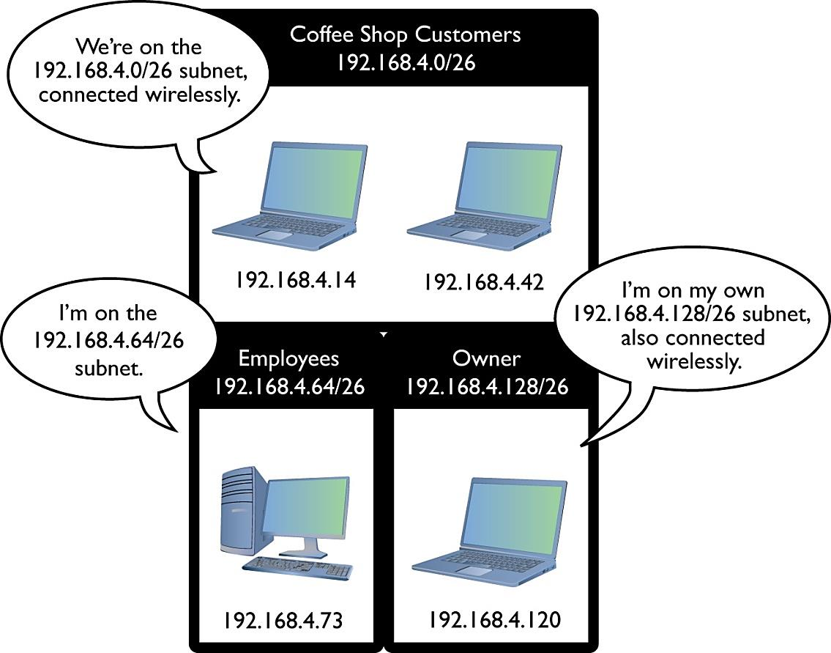
The New Network IDs in Decimal (2 of 2)
Figure 6.37 Three networks using the new network IDs

Slide 93
Creating a /27 subnet (1 of 4)
Move the NE over three digits
Calculate the host address ranges for each usable new subnet

Slide 94
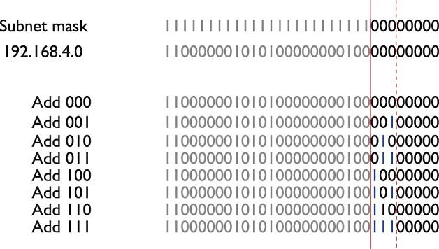
Creating a /27 subnet (2 of 4)
Figure 6.38 Moving the network ID extension three digits

Slide 95
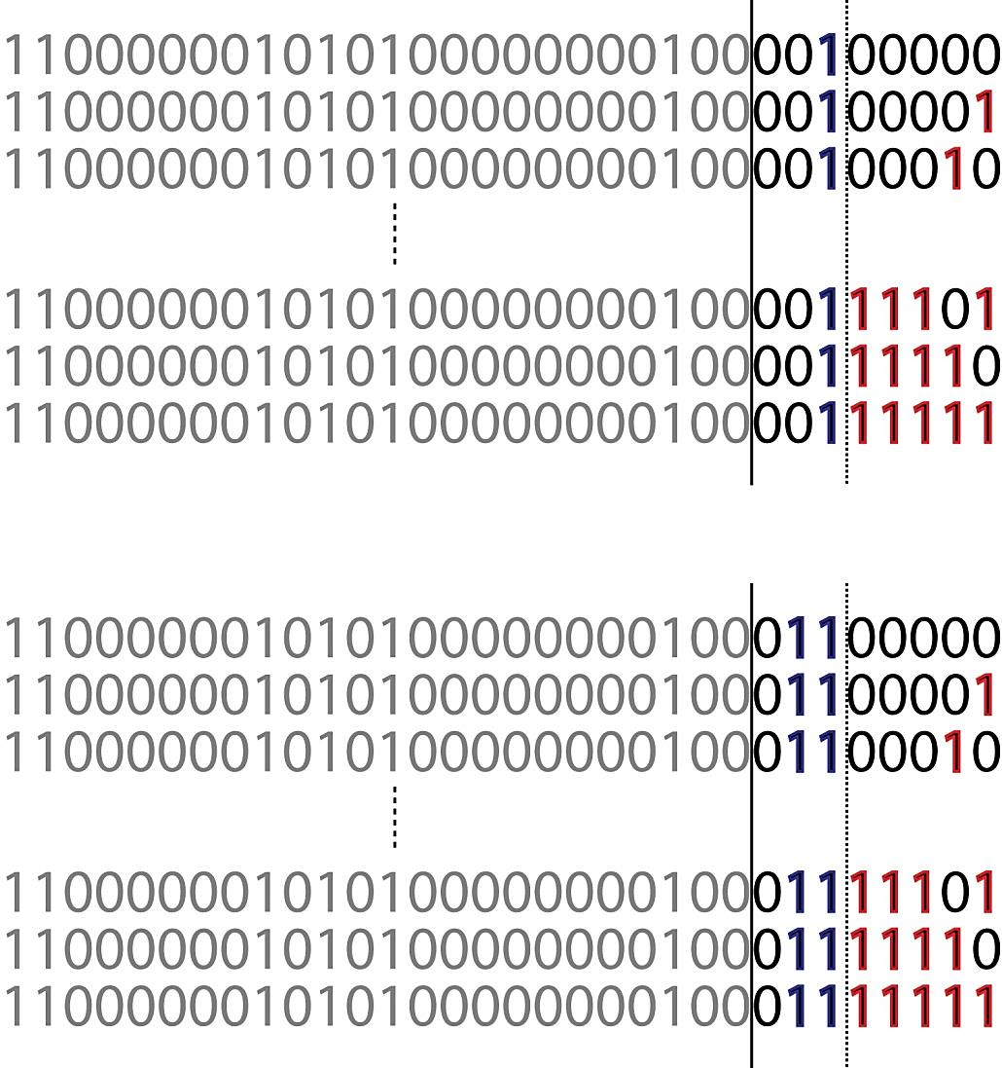
Creating a /27 subnet (3 of 4)
Figure 6.39 Two of the eight network ID address ranges
Notes:
Exam Tip (p.155): CompTIA and many techs refer to a CIDR address as a classless address, meaning the subnet used doesn’t not conform to the big four on the classful side: A, B, C, or D. When you see that term on the exam, you’ll know you should look for subnetting.

Slide 96
Creating a /27 subnet (4 of 4)
192.168.4.0/27 (192.168.4.1 – 192.168.4.30)
192.168.4.32/27 (192.168.4.33 – 192.168.4.62)
192.168.4.64/27 (192.168.4.65 – 192.168.4.94)
192.168.4.96/27 (192.168.4.97 – 192.168.4.126)
192.168.4.128/27 (192.168.4.129 – 192.168.4.158)
192.168.4.160/27 (192.168.4.161 – 192.168.4.190)
192.168.4.192/27 (192.168.4.193 – 192.168.4.222)
192.168.4.224/27 (192.168.4.225 – 192.168.4.254)
Notes:
Tech Tip: ISPs and Classless Addresses (p. 155)
If you order real, unique, ready-for-the-Internet IP addresses from your local ISP, you’ll invariably get a classless set of IP addresses. More importantly, when you order them for clients, you need to be able to explain why their subnet mask is 255.255.255.192, when all the books they read tell them it should be 255.255.255.0!
All this assumes you can get an IPv4 address by the time you’re reading this book. See Chapter 12 for the scoop on IPv6, the addressing scheme of the future.

Slide 97
Manual Dotted Decimal to Binary Conversion
Write bit values in decimal from left to right
Take binary value and place ones and zeroes under appropriate positions
128 64 32 16 8 4 2 1
1 0 0 1 0 1 1 0
Add the decimal values that have a 1 underneath
128 + 16 + 4 + 2 = 150

Slide 98
Manual Decimal to Binary Conversion (1 of 2)
Manually converting 221 decimal to binary
Start with bit values beginning with 128
Place decimal value above the first value on the left which it exceeds and subtract and place a one to represent this binary value
221
128 64 32 16 8 4 2 1
93
1

Slide 99
Manual Decimal to Binary Conversion (2 of 2)
Place the remainder above the next bit value that it exceeds (place a zero in positions that are skipped)
93 29 29 13 5 1
128 64 32 16 8 4 2 1
29 13 5 1
1 1 0 1 1 1 0 1
Decimal 221 = binary 11011101
Notes:
Exam Tip (p. 157): Make sure you can manually convert decimal to binary and binary to decimal.

Slide 100
CIDR: Subnetting in the Real World
Two situations in which subnetting takes place
ISPs receive network blocks from IANA and subnet for customers
Very large customers take subnets from ISPs and make their own subnets
Notes:
Exam Tip (p. 157): Expect to see a question or two on the CompTIA Network+ exam that asks you to compare CIDR notation (IPv4 vs. IPv6). The former should be familiar, with four octets and a /# for the subnet mask. See Chapter 12 for IPv6.

Slide 101
Why Learn Subnetting?
The CompTIA Network+ exam requires it
There is a good chance you will contact an ISP and get CIDR addresses
Think of subnets in terms of CIDR values like /10, /22, /26, and so on
More advanced IT certifications (Cisco, Microsoft, and so on) require this knowledge

Slide 102
IP Address Assignment

Slide 103
Giving a Computer an IP Address
Static addressing
Type in all the information
Dynamic addressing
Server automatically passes out IP information to systems as they connect to the network
Notes:
Exam Tip (p. 158): The CompTIA Network+ exam objectives call the methods for setting up devices for IP addresses IP address assignment. Note that that term applies to both static and dynamic methods (discussed here).

Slide 104
Static IP Addressing (1 of 2)
Class C network block for 197.156.4.0/24
You can do whatever you want with your own network ID
Use a legitimate IP address and subnet mask for the network ID
Every IP address must be unique
You do not have to use the numbers in order
You do not have to use 197.156.4.1 as the default gateway

Slide 105
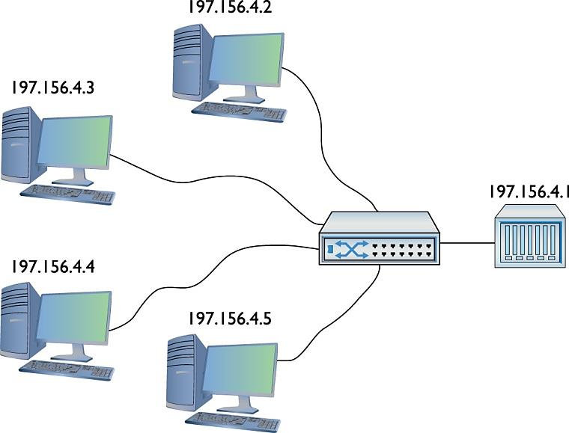
Static IP Addressing (2 of 2)
Figure 6.40 A small network

Slide 106
Static IP Addressing: Common Principles (1 of 5)
Give the default gateway the first host IP address in the network ID
Try to use the IP addresses in some kind of sequential order
Try to separate servers from clients
Servers host addresses: 197.156.4.10 to 197.156.4.19
Client host addresses: 197.156.4.200 to 197.156.4.254
Write down whatever you do so the person who comes after you understands

Slide 107
Static IP Addressing: Common Principles (2 of 5)
Give each computer an IP address, subnet mask, and default gateway
Windows: Internet Protocol Version 4 (TCP/IPv4) Properties dialog box
macOS: Network utility in System Preferences
UNIX/Linux: ifconfig command from the command line: address will be lost upon reboot
Network Configuration program in Ubuntu Linux distro

Slide 108
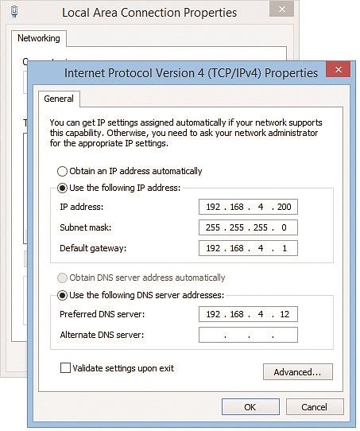
Static IP Addressing: Common Principles (3 of 5)
Figure 6.41 Entering static IP information in Windows Internet Protocol Version 4 (TCP/IPv4) Properties
Notes:
Exam Tip (p. 159): You might get a question about setting a static IP address in Linux where ip isn’t one of the choices. Go with the deprecated ifconfig command in that case.
Check out the excellent “Static IP in Linux” Show! over at http://totalsem.com/007. It’ll take you through the process of setting up a static IP in a typical Linux distro.

Slide 109
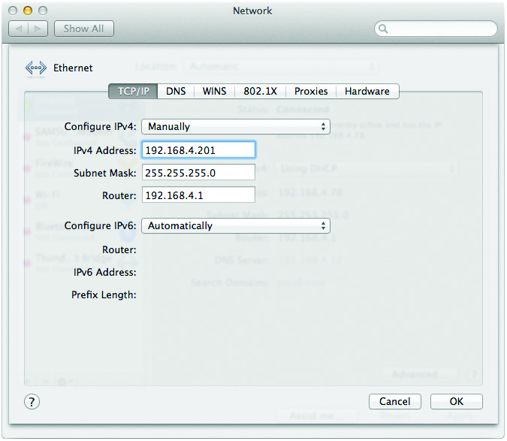
Static IP Addressing: Common Principles (4 of 5)
Figure 6.42 Entering static IP information
in the macOS Network utility

Slide 110
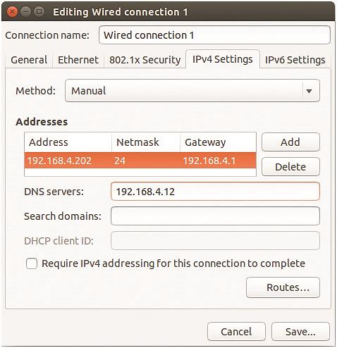
Static IP Addressing: Common Principles (5 of 5)
Figure 6.43 Ubuntu’s Network Configuration utility

Slide 111
Verifying with ping (1 of 2)
Always verify with the ping command
If the ping is not successful
Check your IP settings
Check connections, driver, and so on
Static addressing is still used for most critical systems
Most systems today use dynamic IP addressing
Notes:
Caution (p. 160): Always verify with ping—it’s too easy to make a typo when you entering static IP addresses.
Exam Tip (p. 160):
A very early protocol called Bootstrap Protocol (BOOTP) preceded DHCP in providing dynamic IP addressing. It’s been dead for many decades, but has been known to appear, zombie-like, on CompTIA exams. If you see BOOTP or BootP, substitute DHCP and you’ll see the right answer.

Slide 112
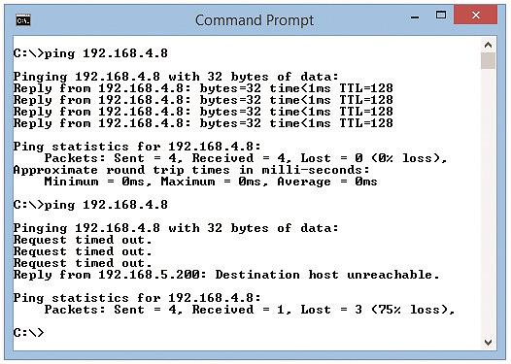
Verifying with ping (2 of 2)
Figure 6.44 Two pings (successful ping on top, unsuccessful ping on bottom)

Slide 113
Dynamic IP Addressing (1 of 2)
Dynamic Host Configuration Protocol (DHCP) automatically assigns an IP address when a computer connects to the network
DHCP process
A computer is configured to use DHCP
Every OS has a method to tell a computer to use DHCP
Notes:
Note (p. 161): Using the acronym DORA— for Discover, Offer, Request, and Acknowledgement—will help you remember the DHCP four-way handshake.
Exam Tip (p. 161): DHCP uses UDP ports 67 and 68. And yes, memorize the numbers.
Check out the excellent Chapter 6 “DHCP Client Setup” Click! over at http://totalsem .com/007. It walks you through the process of setting up DHCP in Windows.

Slide 114
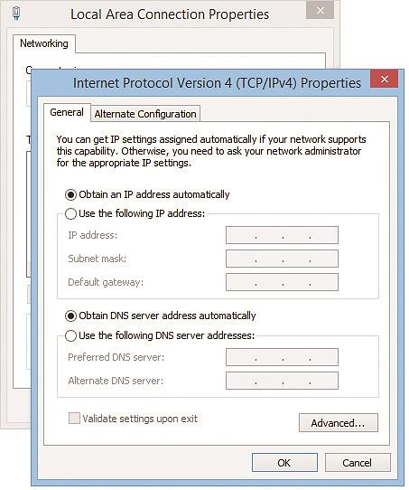
Dynamic IP Addressing (2 of 2)
Figure 6.49 Setting up for DHCP

Slide 115
How DHCP Works (1 of 5)
The DHCP server is configured to pass out IP addresses to DHCP clients
Scope = range of IP addresses
Subnet mask for scope
Default gateway for scope
Other options (default gateway, DNS server, network time server, and more)

Slide 116
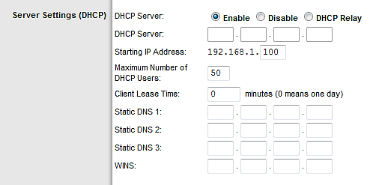
How DHCP Works (2 of 5)
Figure 6.50 DHCP server main screen

Slide 117
How DHCP Works (3 of 5)
Figure 6.52 DHCP relays enable DHCP traffic to cross routers
Notes:
Note (p. 163): The CompTIA objectives list DHCP TTL (Time to Live?) as something of interest. As a 25-year user of DHCP, I’ve never had this issue. After much research, there are some DHCP clients that need a TTL setting to determine how many routers (hops) a DHCP relay can be from the IP helper. I say “Nuts” to CompTIA.

Slide 118
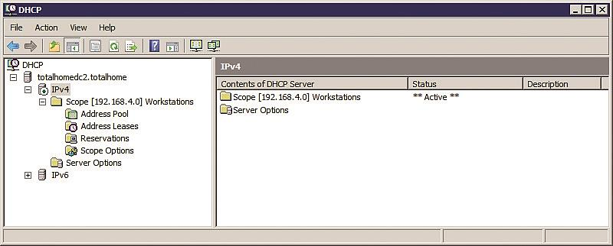
How DHCP Works (4 of 5)
Figure 6.56 DHCP Server configuration screen

Slide 119
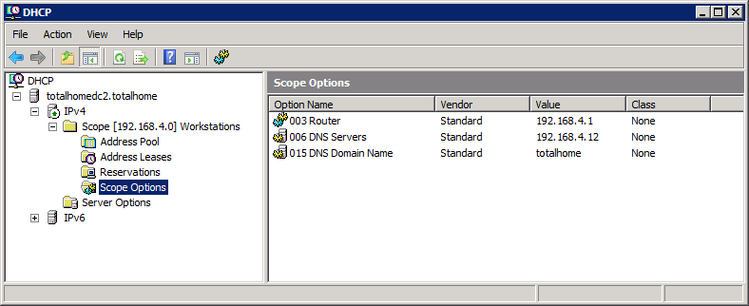
How DHCP Works (5 of 5)
Figure 6.57 DHCP Server Options screen

Slide 120
Living with DHCP (1 of 2)
Very popular
Possible problems
DHCP client tries to get a DHCP address and fails
OS will post an error
The DHCP client will have an address in the 169.254.0.0/16 network ID
This special address is generated by a version of zero-configuration networking (zeroconf ); example – Microsoft’s Automatic Private IP Addressing (APIPA)

Slide 121
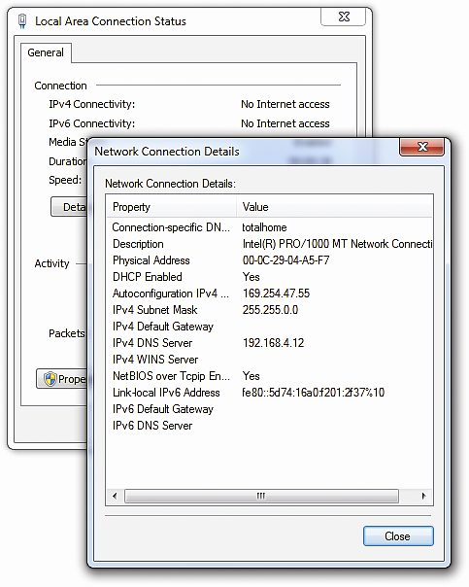
Living with DHCP (2 of 2)
Figure 6.58 DHCP error in Windows 7

Slide 122
APIPA (1 of 2)
APIPA allows computers on a single network to communicate
No default gateway
Clients using APIPA cannot access the Internet
Use an available tool to check IP address
If you see an APIPA address, you know you have a DHCP problem
Notes:
Exam Tip (p. 166): Systems that use static IP addressing can never have DHCP problems.

Slide 123
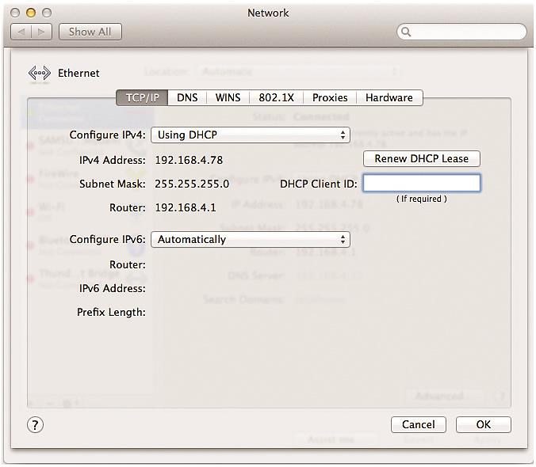
APIPA (2 of 2)
Figure 6.59 Network utility in System Preferences

Slide 124
Reestablish the Lease Manually
Windows: ipconfig /renew
Mac: Network utility under System Preferences
May need to force the release
Windows command line: ipconfig /release; ipconfig /renew
Linux: sudo ifconfig eth0 down; sudo ifconfig eth0 up
Notes:
Exam Tip (p. 166): CompTIA loves TCP and UDP port numbers, so make sure you know that DHCP and BOOTP servers use UDP port 67 and clients use port 68.

Slide 125
Special IP Addresses (1 of 2)
Loopback address: 127.0.0.1
Use to send packets from a device to itself
Use with the ping command
Notes:
Exam Tip (p. 167): Make sure you know how to configure your computers to use static IP addressing and know that you use ping to ensure they can communicate. For dynamic IP addressing, make sure you know DHCP. Understand that each client must have some way to “turn on” DHCP. Also understand the concept of a DHCP client and a DHCP server. Be comfortable with APIPA and releasing and renewing a lease on a client.
Note (p. 168): Good network admins always know their network IDs!
Exam Tip (p. 168): Even though, by convention, you use 127.0.0.1 as the loopback address, the entire 127.0.0.0/8 subnet is reserved for loopback addresses! You can use any address in the 127.0.0.0/8 subnet as a loopback address.

Slide 126
Special IP Addresses (2 of 2)
Private IP addresses
10.0.0.0 through 10.255.255.255 (1 Class A network block)
172.16.0.0. through 172.31.255.255 (16 Class B network block)
192.168.0.0 through 192.168.255.255 (256 Class C network block)
All other IP addresses are public IP addresses
Notes:
Exam Tip (p. 168): Make sure you can quickly tell the difference between a private IP address and a public IP address for the CompTIA Network+ exam. The objectives mention the distinction as private vs. public.

